Slide 1

Introductory Statistics
Introductory Statistics

Slide 2
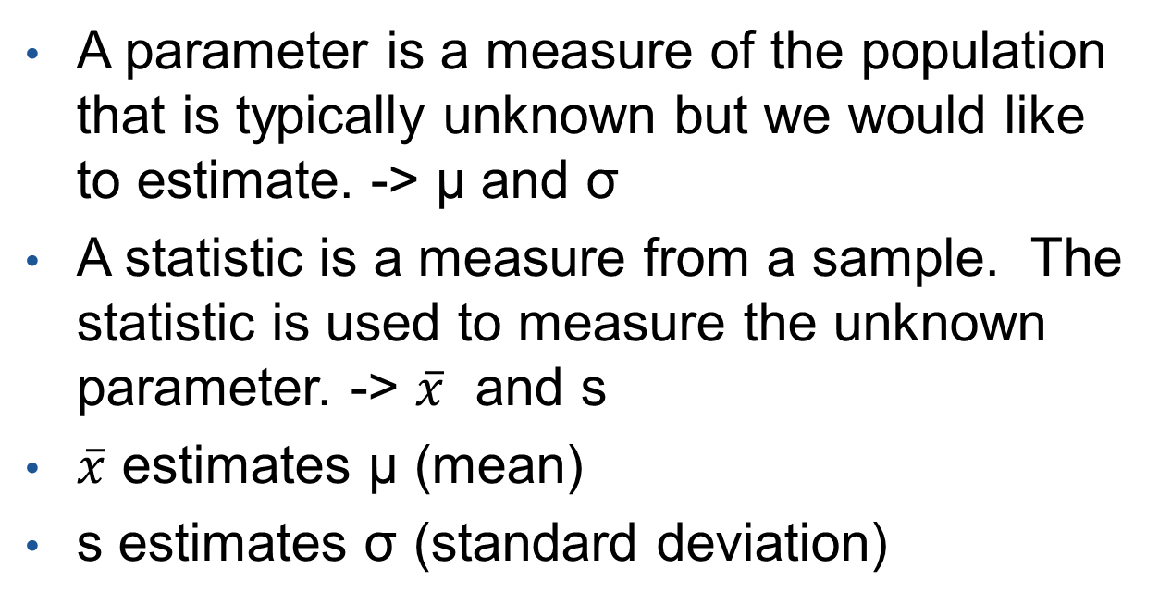
Parameter and Statistic
A parameter is a measure of the population that is typically unknown but we would like to estimate. -> µ and σ
A statistic is a measure from a sample. The statistic is used to measure the unknown parameter. -> $\overline{x}$ and s
$\overline{x}$ estimates µ (mean)
s estimates σ (standard deviation)

Slide 3
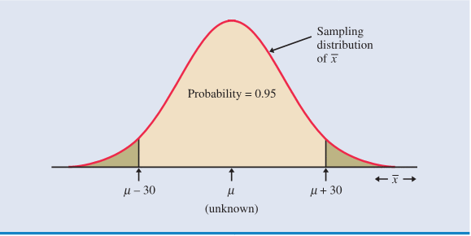
Distribution of Sample Means
Sampling Distributions has many sample means from many possible samples
Due to time and money, one cannot take multiple samples or sample the whole population. So, we infer based on one sample.
The statistic (the sample mean) can be anywhere in the distribution of sample means.
“The Distribution of Means”

Slide 4
Confidence Interval
A confidence interval for an unknown parameter consists of an interval of numbers.
Point Estimate ±Margin of Error (Sampling Error)
Example: People voting for Barack Obama (Pre-election polling)
What does a confidence interval mean? - We are X% confident that the true value is between (Lower Limit, Upper Limit)
“The Distribution of Means”

Slide 5
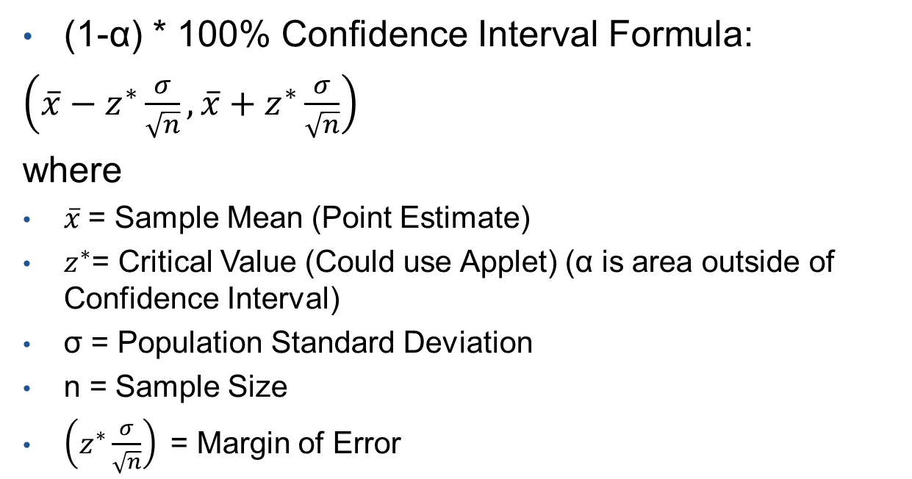
Confidence Interval (Con’t)
(1-α) * 100% Confidence Interval Formula:
$\left(\overline{x}−z^{∗}\frac{σ}{\sqrt{n}},\overline{x}+z^{∗}\frac{σ}{\sqrt{n}}\right)$
where
$\overline{x}$= Sample Mean (Point Estimate)
$z^{∗}$= Critical Value (Could use Applet) (α is area outside of Confidence Interval)
σ = Population Standard Deviation
n = Sample Size
$\left(z^{∗}\frac{σ}{\sqrt{n}}\right)$= Margin of Error
“The Distribution of Nickels”

Slide 6
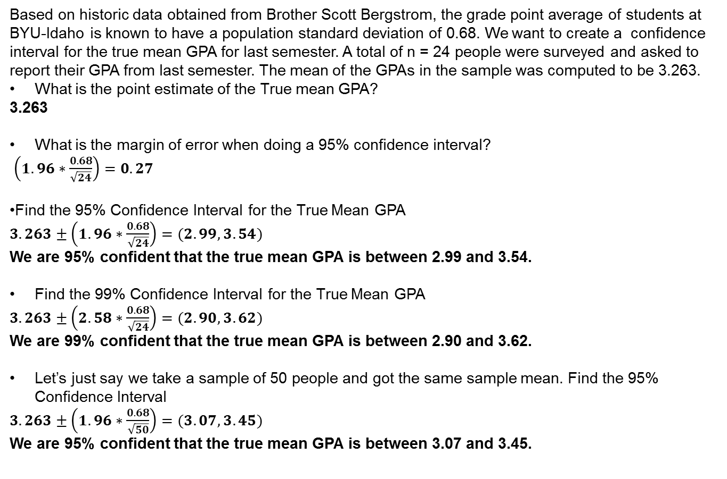

Confidence Interval (Example)
Based on historic data obtained from Brother Scott Bergstrom, the grade point average of students at BYU-Idaho is known to have a population standard deviation of 0.68. We want to create a confidence interval for the true mean GPA for last semester. A total of n = 24 people were surveyed and asked to report their GPA from last semester. The mean of the GPAs in the sample was computed to be 3.263.
What is the point estimate of the True mean GPA?
3.263
What is the margin of error when doing a 95% confidence interval?
$\left(1.96∗\frac{0.68}{\sqrt{24}}\right)=0.27$
Find the 95% Confidence Interval for the True Mean GPA
$3.263±\left(1.96∗\frac{0.68}{\sqrt{24}}\right)=(2.99, 3.54)$
We are 95% confident that the true mean GPA is between 2.99 and 3.54.
Find the 99% Confidence Interval for the True Mean GPA
$3.263±\left(2.58∗\frac{0.68}{\sqrt{24}}\right)=(2.90, 3.62)$
We are 99% confident that the true mean GPA is between 2.90 and 3.62.
Let’s just say we take a sample of 50 people and got the same sample mean. Find the 95% Confidence Interval
$3.263±\left(1.96∗\frac{0.68}{\sqrt{50}}\right)=(3.07, 3.45)$
We are 95% confident that the true mean GPA is between 3.07 and 3.45.
$\left(\overline{x}−z^{∗}\frac{σ}{\sqrt{n}},\overline{x}+z^{∗}\frac{σ}{\sqrt{n}}\right)$

Slide 7
Confidence Interval
What happens to the width of the confidence interval as the level of confidence and the sample size increase?
As level of confidence increases, the width of the confidence interval increases
As sample size increases, the width of the confidence interval decreases

Slide 8
Requirements for Confidence Interval
Requirements for Confidence Interval for One Sample, σ known
Sample is Simple Random Sample
Population Standard Deviation σ is known
Either of these conditions are satisfied:
  Population is normally distributed
  Sample Size (n) is greater than 30
Requirement Met Due to the Central Limit Theorem

Slide 9
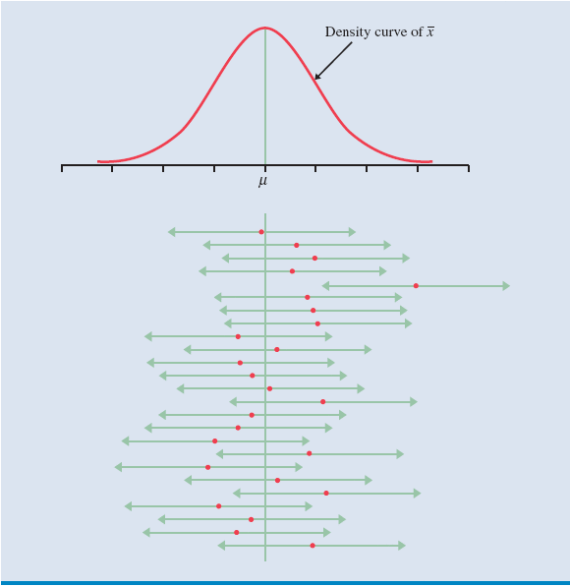

Final Thoughts on Confidence Intervals
A level of confidence describes the process of creating an interval that predicts the mean, µ, which is unknown. Approx. (1-α) *100% of all possible confidence intervals will contain µ.
This does not mean the probability of containing µ. The interval captured it or it did not. (Prob. = 0 or 1).
The sample size required to estimate the population mean with the level of confidence (1-α) *100%, with a specified margin or error, m, is given by:

Slide 10
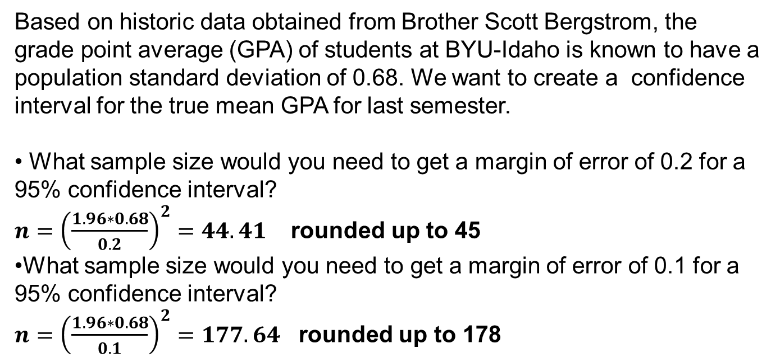
Sample Size Calculations
Based on historic data obtained from Brother Scott Bergstrom, the grade point average (GPA) of students at BYU-Idaho is known to have a population standard deviation of 0.68. We want to create a confidence interval for the true mean GPA for last semester.
What sample size would you need to get a margin of error of 0.2 for a 95% confidence interval?
$n={\left(\frac{1.96∗0.68}{0.2}\right)}^{2}=44.41$ rounded up to 45
What sample size would you need to get a margin of error of 0.1 for a 95% confidence interval?
$n={\left(\frac{1.96∗0.68}{0.1}\right)}^{2}=177.64$ rounded up to 178

